Slide 1
FRENCH CUISINE
IX

Slide 2
HISTORY
Knowledge of French cooking has contributed significantly to Western cuisines. Its criteria are used widely in Western cookery school boards and culinary education. In November 2010, French gastronomy was added by the UNESCO to its lists of the world's "intangible cultural heritage".

Slide 3
National cuisine
Terrine
Bisque
Foie gras
Croque monsieur
Basil salmon
is a smooth and creamy French potage.
with mustard seeds and green onions in duck jus
Sandwich made from ham and cheese

Slide 4
Plat Principal
Pot-au-feu
Steak frites
Blanquette de veau
Is a cuisine Classique dish
is a simple and popular dish.
Is French veal stew

Slide 5
Pâtisserie
Pâtisserie
Mile-feuille
Macaron
Éclair

Slide 6
Dessert
Crème brulèe
Mousse au chocolat
Crepe
Lle flottante

Slide 7
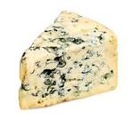
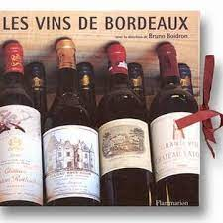
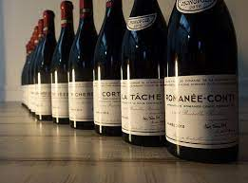
Fromage et vins

